Slide 1
Leadership as safety champions
WELCOME
Dianne Grote Adams, MS, CIH, CSP, CPEA, FAIHA
President

Slide 2
Why Are We Here?
Build development of a strong safety culture

Slide 3
HSE Champions
Discuss the qualities of a good leader
Explain the role of leaders in building/maintaining safety culture
Identify the current status of your ESH leadership abilities
Describe OSHA’s expectations of leadership
Notes:
We will have a combination of small group exercises, individual work and Powerpoint slides to accomplish these objectives

Slide 4
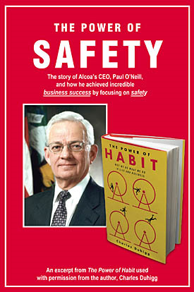
Paul O'Neill CEO of Alcoa It’s All About Safety
https://www.youtube.com/watch?v=tC2ucDs_XJY
Notes:
Paul O’Neill, CEO of Alcoa
1987 to 2000.
Market value increased from $3 billion (1986) to $27.53 billion(2000)
Net income increased from $200 million to $1.48 billion.
Tom: O’Neill began his first speech to Alcoa shareholders in 1987 by saying, “I want to talk to you about worker safety.” The room fell silent. O’Neill continued, “Every year, numerous Alcoa workers are injured so badly that they miss a day of work. Our safety record is better than the general American workforce, especially considering that our employees work with metals that are 1500 degrees and machines that can rip a man’s arm off. But it’s not good enough. I intend to make Alcoa the safest company in America. I intend to go for zero injuries.”

Slide 5
What is a Leader?
Discussion

Slide 6
(Safety) Leader Defined
A person who rules or guides or inspires others
A person that guides, gives direction, and inspires
Leaders cast vision and motivate people
Vision Inspire/Motivate Guide
Notes:
Common theme – cast vision, guides and inspires/motivates
This fits with the factors that contribute to a safety culture.
You have beliefs and attitudes about what safety should be.
You give guidance and inspire employees to be engaged and share the vision.

Slide 7
How Leaders Succeed
Notes:
Many of you have probably read
First break all the rules
the 12 elements of great managing
And leaders eat last.
They are built on the theory that success requires engagement of employees and as leaders, it’s our responsibility to make that happen.
So I agree. And I believe safety is like any other aspect of business. Our leaders must engage our team members.

Slide 8
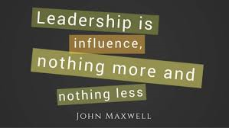
Ability to get followers
Notes:
Everyone influences someone
We never know who or how much we influence
Sociologists tell us that even the most introverted individual will influenc10,000 other people in their lifetime.

Slide 9
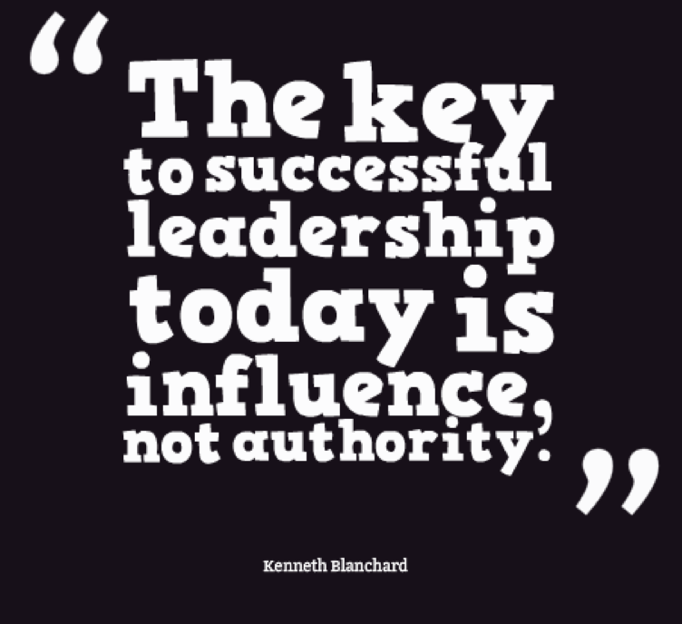
Levels of Leadership¹
05
Personhood
04
03
People Development
02
Production
01
Permission
Position
¹ Developing the Leader Within You, John C. Maxwell
Notes:
Position – basic entry. Only influence comes with title. People who stay at this level get intoterritorial rights, protocols, traditions and organization charts. Not negative, but poor substitute for leadership skills. These people have control because of authority. They follow because they have to.
Permission – Leadership is getting people to work for you when they are not oblifated. They don’t care how much you know until they know how much you care. Begins with the heart, not with the head. Lead by interrelationships. Energy focused on individual’s needs and desires. They follow because they want to
Production: good things begin to happen here; profit increases, morale is high; needs are met; goals are realized. People come together here at this level to accomplish a purpose. They like to get together, but they love to accomplish things. Results oriented. Peeople follow you because of what you have done for the organization
People development – a leader is great because of ability to empower others. Develop others to do the work. Develop a successor. Loytalty reaches peak when follower has personally grown thru the mentoriship of the leader. People follow you because of what you have done for them
Personhood – rarely does anyone reach this level..lifetime of proven leadership to get here. People follow because of who you are and what you represent.
Climbing the ladder – the higher you go, the longer it takes. Each new job, circle of friends, you start at bottom and work your way up again.

Slide 10
How Leaders Get it Done
MOTIVATE
Insight
Initiate
Goals
Resources
Collaborate
Notes:
1 Motivation — inspiring teams to get exceptional work done
2 Workstyle — setting goals and arranging resources for the team to excel
3 Initiation — influencing others to act; pushing through adversity and resistance 4 Collaboration — building committed teams with deep bonds
5 Thought process — taking an analytical approach to strategy and decision-making

Slide 11
How Leaders Succeed
Step 01
Communication
Effective Communication & Listening
Step 02
Trust
Step 03
Relationships
Step 04
Influence
Levels of Leadership

Slide 12
What is Culture?
Discussion

Slide 13
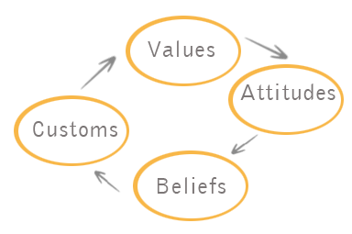
Notes:
Merriam-Webster defines culture as the beliefs, customs, arts, etc. of a particular society, group, place or time.
A particular society that has its own beliefs, way of life, art, etc.
A way of thinking, behaving or working that exists in a place or organization.

Slide 14
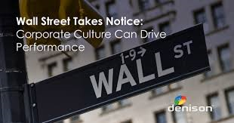

Slide 15
What is Safety?
Discussion

Slide 16
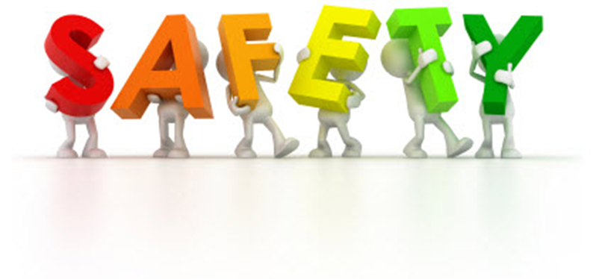
The condition of being protected from or unlikely to cause danger, risk or injury

Slide 17
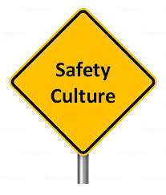
The condition of being protected from or unlikely to cause danger, risk or injury
A way of thinking, behaving or working that exists in a place or organization
Notes:
Creating a culture that values safety

Slide 18
Safety Culture
Management and employee beliefs and attitudes
Values, myths
Policies and procedures
Supervisor priorities, responsibilities and accountability
Practices
Unsafe behavior response
Training
Engagement
Notes:
https://www.osha.gov/SLTC/etools/safetyhealth/mod4_factsheets_culture.html
Why do you want a strong safety culture?
It has been observed at the OSHA VPP sites and confirmed by independent research that developing strong safety cultures have the single greatest impact on incident reduction of any process. It is for this single reason that developing these cultures should be top priority for all managers and supervisors.
What is a safety culture - how will it impact my company?
Safety cultures consist of shared beliefs, practices, and attitudes that exist at an establishment. Culture is the atmosphere created by those beliefs, attitudes, etc., which shape our behavior. An organizations safety culture is the result of a number of factors such as:
Management and employee norms, assumptions and beliefs;
Management and employee attitudes;
Values, myths, stories;
Policies and procedures;
Supervisor priorities, responsibilities and accountability;
Production and bottom line pressures vs. quality issues;
Actions or lack of action to correct unsafe behaviors;
Employee training and motivation; and
Employee involvement or "buy-in."
In a strong safety culture, everyone feels responsible for safety and pursues it on a daily basis; employees go beyond "the call of duty" to identify unsafe conditions and behaviors, and intervene to correct them. For instance, in a strong safety culture any worker would feel comfortable walking up to the plant manager or CEO and reminding him or her to wear safety glasses. This type of behavior would not be viewed as forward or over-zealous but would be valued by the organization and rewarded. Likewise coworkers routinely look out for one another and point out unsafe behaviors to each other.
A company with a strong safety culture typically experiences few at-risk behaviors, consequently they also experience low incident rates, low turn-over, low absenteeism, and high productivity. They are usually companies who are extremely successful by excelling in all aspects of business and excellence.
Creating a safety culture takes time. It is frequently a multi-year process. A series of continuous process improvement steps can be followed to create a safety culture. Employer and employee commitment are hallmarks of a true safety culture where safety is an integral part of daily operations.
A company at the beginning of the road toward developing a safety culture may exhibit a level of safety awareness, consisting of safety posters and warning signs. As more time and commitment are devoted, a company will begin to address physical hazards and may develop safety recognition programs, create safety committees, and start incentive programs.
Top management support of a safety culture often results in acquiring a safety director, providing resources for incident investigations, and safety training. Further progress toward a true safety culture uses accountability systems. These systems establish safety goals, measure safety activities, and charge costs back to the units that incur them. Ultimately, safety becomes everyone's responsibility, not just the safety director's. Safety becomes a value of the organization and is an integral part of operations. Management and employees are committed and involved in preventing losses. Over time the norms and beliefs of the organization shift focus from eliminating hazards to eliminating unsafe behaviors and building systems that proactively improve safety and health conditions. Employee safety and doing something the right way takes precedence over short term production pressures. Simultaneously, production does not suffer but is enhanced due to the level of excellence developed within the organization.
Management Processes Typically Ripe for Improvement:
Define safety responsibilities for all levels of the organization, e.g., safety is a line management function.
Develop upstream measures, e.g., number of reports of hazards/suggestions, number of committee projects/successes, etc.
Align management and supervisors through establishing a shared vision of safety and health goals and objectives vs. production.
Implement a process that holds managers and supervisors accountable for visibly being involved, setting the proper example, and leading a positive change for safety and health.
Evaluate and rebuild any incentives & disciplinary systems for safety and health as necessary.
Ensure the safety committee is functioning appropriately, e.g., membership, responsibilities/functions, authority, meeting management skills, etc.
Provide multiple paths for employees to bring suggestions, concerns, or problems forward. One mechanism should use the chain of command and ensure no repercussions. Hold supervisors and middle managers accountable for being responsive.
Develop a system that tracks and ensures the timeliness in hazard correction. Many sites have been successful in building this in with an already existing work order system.
Ensure reporting of injuries, first aids, and near misses. Educate employees on the incident pyramid and importance of reporting minor incidents. Prepare management for initial increase in incidents and rise in rates. This will occur if under-reporting exists in the organization. It will level off, then decline as the system changes take hold.
Evaluate and rebuild the incident investigation system as necessary to ensure that it is timely, complete, and effective. It should get to the root causes and avoid blaming workers.
Building a safety culture
Any process that brings all levels within the organization together to work on a common goal that everyone holds in high value will strengthen the organizational culture. Worker safety and health is a unique area that can do this. It is one of the few initiatives that offer significant benefits for the front-line work force. As a result, buy-in can be achieved enabling the organization to effectively implement change. Obtaining front line buy-in for improving worker safety and health is much easier than it is to get buy-in for improving quality or increasing profitability. When the needed process improvements, are implemented all three areas typically improve and a culture is developed that supports continuous improvement in all areas. The following represents the major processes and milestones that are needed to successfully implement a change process for safety and health. It is intended to focus you on the process rather than individual tasks. It is common to have a tendency to focus on the accomplishment of tasks, i.e., to train everyone on a particular concern or topic or implement a new procedure for incident investigations, etc. Sites that maintain their focus on the larger process to be followed are far more successful. They can see the "forest" from the "trees" and thus can make mid-course adjustments as needed. They never lose sight of their intended goals, therefore, they tend not to get distracted or allow obstacles to interfere with their mission. The process itself will take care of the task implementation and ensure that the appropriate resources are provided and priorities are set.
Obtain Top Management "Buy-in" - This is the very first step that needs to be accomplished. Top managers must be on board. If they are not, safety and health will compete against core business issues such as production and profitability, a battle that will almost always be lost. They need to understand the need for change and be willing to support it. Showing the costs to the organization in terms of dollars (direct and indirect costs of incidents) that are being lost, and the organizational costs (fear, lack of trust, feeling of being used, etc.) can be compelling reasons for looking at needing to do something different. Because losses due to incidents are bottom line costs to the organization, controlling these will more than pay for the needed changes. In addition, when successful, you will also go a long way in eliminating organizational barriers such as fear, lack of trust, etc.: Issues that typically get in the way of everything that the organization wants to do.
Continue Building "Buy-in" for the needed changes by building an alliance or partnership between management, the union (if one exists), and employees. A compelling reason for the change must be spelled out to everyone. People have to understand WHY they are being asked to change what they normally do and what it will look like if they are successful. This needs to be done up front. If people get wind that something "is going down" and haven't been formally told anything, they naturally tend to resist and opt out.
Build Trust - Trusting is a critical part of accepting change and management needs to know that this is the bigger picture, outside of all the details. Trust will occur as different levels within the organization work together and begin to see success.
Conduct Self Assessments/Bench Marking - To get where you want to go, you must know where you are starting from. A variety of self-audit mechanisms can be employed to compare your site processes with other recognized models of excellence such as Star VPP sites. Visiting other sites to gain first hand information is also invaluable.
Initial Training of Management-Supervisory staff, Union Leadership (if present), and safety and health committee members, and a representative number of hourly employees. This may include both safety and health training and any needed management, team building, hazard recognition, or communication training, etc. This gives you a core group of people to draw upon as resources and also gets key personnel onboard with needed changes.
Establish a Steering Committee comprised of management, employees, union (if one exists), and safety staff. The purpose of this group is to facilitate, support, and direct the change processes. This will provide overall guidance and direction and avoid duplication of efforts. To be effective, the group must have the authority to get things done.
Develop Site Safety Vision, key policies, goals, measures, and strategic and operational plans. These policies provide guidance and serve as a check-in that can be used to ask yourself if the decision you're about to make supports or detracts from your intended safety and health improvement process.
Align the Organization by establishing a shared vision of safety and health goals and objectives vs. production. Upper management must be willing to support by providing resources (time) and holding managers and supervisors accountable for doing the same. The entire management and supervisory staff need to set the example and lead the change. It's more about leadership than management.
Define Specific Roles and responsibilities for safety and health at all levels of the organization. Safety and health must be viewed as everyone's responsibility. How the organization is to deal with competing pressures and priorities, i.e., production, versus safety and health, needs to be clearly spelled out.
Develop a System of Accountability for all levels of the organization. Everyone must play by the same rules and be held accountable for their areas of responsibility. Signs of a strong culture is when the individuals hold themselves accountable.
Develop Measures and an ongoing measurement and feedback system. Drive the system with upstream activity measures that encourages positive change. Examples include the number of hazards reported or corrected, numbers of inspections, number of equipment checks, JSA's, pre-start-up reviews conducted, etc.
While it is always nice to know what the bottom line performance is, i.e., incident rates, overemphasis on these and using them to drive the system typically only drives incident reporting under the table. It is all too easy to manipulate incident rates which will only result in risk issues remaining unresolved and a probability for more serious events to occur in the future.
Develop Policies for Recognition, rewards, incentives, and ceremonies. Again, reward employees for doing the right things and encourage participation in the upstream activities. Continually reevaluate these policies to ensure their effectiveness and to ensure that they do not become entitlement programs.
Awareness Training and Kick-off for all employees. It's not enough for a part of the organization to be involved and know about the change effort - the entire site needs to know and be involved in some manner. A kick-off celebration can be used to announce it's a "new day" and seek buy-in for any new procedures and programs.
Implement Process Changes via involvement of management, union (if one is present), and employees using a "Plan To Act" process Total Quality Management (TQM).
Continually Measure performance, Communicate Results, and Celebrate Successes. Publicizing results is very important to sustaining efforts and keeping everyone motivated. Everyone needs to be updated throughout the process. Progress reports during normal shift meetings allowing time for comments back to the steering committee opens communications, but also allows for input. Everyone needs to have a voice, otherwise, they will be reluctant to buy-in. A system can be as simple as using current meetings, a bulletin board, and a comment box.
On-going Support - Reinforcement, feedback, reassessment, mid-course corrections, and on-going training is vital to sustaining continuous improvement.
Back to Top

Slide 19
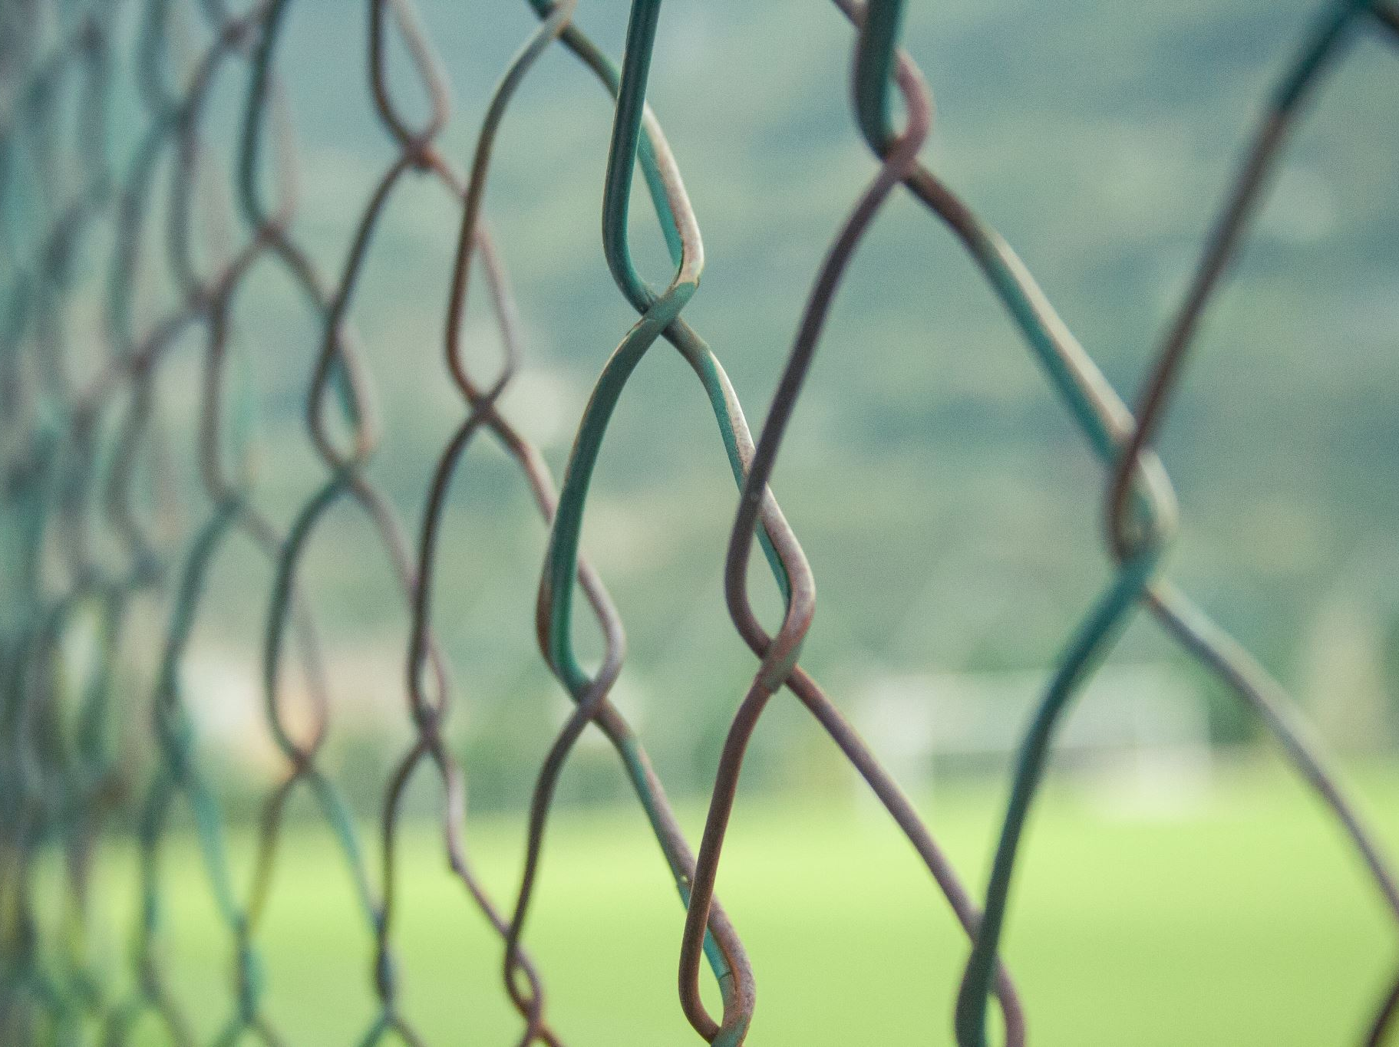
Barriers to a Strong Safety Culture
Small Group Discussion
Notes:
This exercise gives us a chance to apply the qualities of great leaders to specific safety-related behaviors and to assess our own starting places.
The answers won’t be shared, unless you choose to share them during our discussion
Takes 10-20 minutes.
Discuss the results once participants have completed the self assessment.

Slide 20
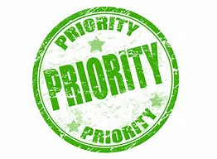
Notes:
Tom:
I think there is a difference between priority and leading through values? Well, it starts with knowing the difference between values and priorities. I have a funny story to illustrate the difference. People get ready for work in different ways. Some people get up early and go for a run and come into work with a bunch of energy. I don’t like working with those people early in the morning but they exist. Other people might drink their coffee and read the news and come into work in Zen-like manner. I like working with those people. And then some folks hit the snooze alarm 4-5 times and get into work at the last minute. We all get ready for work in different ways. But let’s say, regardless of how you get ready for work, you wake up and you’re late. You know your late. What’s the one thing you’re guaranteed to do before getting to work? [Usually, there are several answers to this that don’t quite fit until someone figures out that we’d all get dressed]. Yes, get dressed. We’d all get dressed. And imagine if someone showed up to work not dressed. Would it be instantly rejected by not just the supervisor but by the other employees? Of course. And that’s the difference between a value and a priority. Our values are deeply ingrained and often happen automatically. Our priorities change – we might skip the shower – that’s a priority and usually an important one – but we’re not skipping clothes – at least I hope not. Our values don’t change. Priorities do. The question I’d ask is – is safety more of a priority or a value in your organization? If someone did something contrary to safe work practices, would employees instantly reject it? If not, there’s probably some work to do.

Slide 21
OSHA Perspective
Employer (Supervisor) responsibilities include:
Workplace free from recognized hazards
Examine workplace conditions
Assure employees have safety equipment
Provide effective training
Notes:
Employer Responsibilities – supervisors are employer representatives
Under the OSH law, employers have a responsibility to provide a safe workplace. This is a short summary of key employer responsibilities:
Provide a workplace free from serious recognized hazards and comply with standards, rules and regulations issued under the OSH Act.
Examine workplace conditions to make sure they conform to applicable OSHA standards.
Make sure employees have and use safe tools and equipment and properly maintain this equipment.
Use color codes, posters, labels or signs to warn employees of potential hazards.
Establish or update operating procedures and communicate them so that employees follow safety and health requirements.
Employers must provide safety training in a language and vocabulary workers can understand.
Employers with hazardous chemicals in the workplace must develop and implement a written hazard communication program and train employees on the hazards they are exposed to and proper precautions (and a copy of safety data sheets must be readily available). See the OSHA page on Hazard Communication.
Provide medical examinations and training when required by OSHA standards.
Post, at a prominent location within the workplace, the OSHA poster (or the state-plan equivalent) informing employees of their rights and responsibilities.
Report to the nearest OSHA office all work-related fatalities within 8 hours, and all work-related inpatient hospitalizations, all amputations and all losses of an eye within 24 hours. Call our toll-free number: 1-800-321-OSHA (6742); TTY 1-877-889-5627. [Employers under federal OSHA's jurisdiction were required to begin reporting by Jan. 1, 2015. Establishments in a state with a state-run OSHA program should contact their state plan for the implementation date].
Keep records of work-related injuries and illnesses. (Note: Employers with 10 or fewer employees and employers in certain low-hazard industries are exempt from this requirement.
Provide employees, former employees and their representatives access to the Log of Work-Related Injuries and Illnesses (OSHA Form 300). On February 1, and for three months, covered employers must post the summary of the OSHA log of injuries and illnesses (OSHA Form 300A).
Provide access to employee medical records and exposure records to employees or their authorized representatives.
Provide to the OSHA compliance officer the names of authorized employee representatives who may be asked to accompany the compliance officer during an inspection.
Not discriminate against employees who exercise their rights under the Act. See our "Whistleblower Protection" webpage.
Post OSHA citations at or near the work area involved. Each citation must remain posted until the violation has been corrected, or for three working days, whichever is longer. Post abatement verification documents or tags.
Correct cited violations by the deadline set in the OSHA citation and submit required abatement verification documentation.
OSHA encourages all employers to adopt an Injury and Illness Prevention Program. Injury and Illness Prevention Programs, known by a variety of names, are universal interventions that can substantially reduce the number and severity of workplace injuries and alleviate the associated financial burdens on U.S. workplaces. Many states have requirements or voluntary guidelines for workplace Injury and Illness Prevention Programs. Also, numerous employers in the United States already manage safety using Injury and Illness Prevention Programs, and we believe that all employers can and should do the same. Most successful Injury and Illness Prevention Programs are based on a common set of key elements. These include: management leadership, worker participation, hazard identification, hazard prevention and control, education and training, and program evaluation and improvement. OSHA’s Injury and Illness Prevention Programs topics page contains more information including examples of programs and systems that have reduced workplace injuries and illnesses.
For more information, refer to the following online publications and resources. All About OSHA* OSHA Inspections* Top Ten OSHA Standards Cited
For more information, see OSHA's enforcement page

Slide 22
Good Leadership Linked with Healthy Workers
Employees working under good leadership were found to be..
40% more likely to fall into the highest category of well-being (lowest levels of stress, anxiety and depression)
27% reduction in sick leave
46% reduction in disability pensions
Journal of Occupational and Environmental Medicine (Vol. 50, Issue 8)

Slide 23
You cannot sell(influence) anything until you, yourself are sold

Slide 24
VISION
Vision is dreaming with your eyes wide open. -Willie Jolley
Notes:
What is your vision? Zero incidents? specific targets?

Slide 25
Leadership Skills
GOALS: Let them know what you expect
TOOLS: Provide them the tools and resources to do the job
FEEDBACK: Measure performance and let them know how their doing
COACHING: Help them succeed
ACCOUNTABILITY: Hold people accountable for results and how those results are achieved
Notes:
TOM: As we build trust and relationships, it’s important to set clear goals – people need to know what is expected and we must be specific. Then we provide the tools and resources to get the job done – that’s everything from PPE to training to the time to work on safety. We also should provide feedback often. I hate performance appraisals and the reason I hate performance appraisals is because managers often wait until the performance appraisal to give feedback. Feedback is constant. That goes for positive feedback and corrective. Then, leadership takes coaching. Coaching people means engaging them and helping them to solve their problems, overcome their own obstacles, and build necessary skills. Coaches must listen and must ask great questions. And, finally, the glue that hold this entire thing together is accountability. I’m not talking about suspending people or writing them up – though that’s sometimes necessary. But what I’m really talking about is that deep sense of accountability we must have to ourselves, our families and friends, and to our co-workers. If you’ve ever met a spouse of a severally injured employee at the emergency room, you know accountability. I’ll take a write up or a suspension any day over that feeling.
DGA: yes, I’ve been in that situation before.

Slide 26
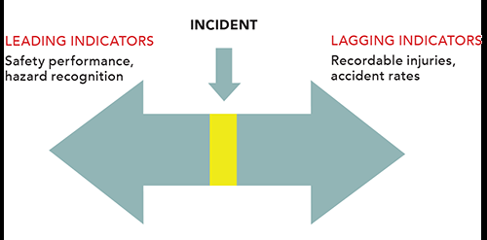
Goals
Leading Indicators
Lagging Indicators

Slide 27
Tools
Time
Proper equipment
PPE

Slide 28
Feedback and Coaching
Timely
Make it personal
Self discovery
Notes:
Give some examples.

Slide 29
Effective Feedback and Coaching What Else is Critical?
Communicate and build trust
Repetitively
Deliver what you promise
Develop relationships on personal level
Environment is constantly changing
People forget fast
Other competing messages
Invested time and $ to date you don’t want to lose
Notes:
Goals – RbR reasonable but reaching; BAG – big audacious goal with frequent repetitive communication. Don’t’ stop at incident rates. Goals should also be proactive - % of folks that are on time with training, % of department audits done, % of safety committee items that are responded to within established timeframe.
Communicate repetitively. If don’t hear the goal monthly may think it’s no longer a goal! Get departments, others involved in goal setting process.
Communicate and build trust – open frequent communication – safety committees, walk around, safety suggestion box
Track progress publicly
Celebrate successes – while $ is nice, most people WANT RECOGNITION!
We are going to talk about the asteriked items.

Slide 30
Hold Accountable
Enforce the ESH Program
Managers, supervisors, crew leaders, peers
Performance Measures
Supervisors, managers, employees
Leading vs. Lagging Indicators
Discipline Program
Consistent with rest of your policies
Something you do ‘for’ someone, not ‘to’ someone
“Promote standards in order for an individual to choose to be at their best.”
Notes:
discipline policy and performance measures prior to presenting.

Slide 31
Employee Engagement
Involve Workers in All Aspects
Develop program and goals
Report hazards and solutions
Analyze hazards
Define safe work practices/JHA
Conduct site inspections
Develop/revise safety procedures
Participate in investigations
Train coworkers/new hires
Develop training programs
Evaluate program performance
Notes:
These activities increase hazard recognition and corrective actions. I don’t know what I don’t know unless I received knowledge. Spreading the activities raises the base knowledge and increases recognition and expectation.

Slide 32
Colin Powell
“The essence of leadership is holding your people to the highest possible standard while taking the best possible care of them.”

Slide 33
What Else is Critical?
Evaluate your message
People buy benefits, not features
Get attention
Motivate to do something
Track progress publicly
Recognize
Celebrate successes

Slide 34
Common Sense
…is a myth
Based on assumption everyone has same training, life experience and uses same thought process to reach same conclusion
Decisions based on personal perception of risk and reward
Build a safe work culture through reinforcing safety behaviors
Source: Safety and Health Magazine, Oct. 2008
Notes:
Give an example: You say “be careful on that ladder”. The person being observed does not understand that means they can’t stand on the top step, they shouldn’t wear high heels, 3 points of contact, etc.

Slide 35
Positive Safety Culture
Sell yourself on the idea of safety!
If you are not sold on the idea, you won’t be able to sell it to your team.
Find your “why”
Discover what employees’ value--it might not be the same for everyone.
Use this to drive employees to make safer choices around the workplace.
Build relationships
Be present and approachable.
Take notice
If you see an associate wearing excess or non-mandatory PPE, or not wearing PPE
Notes:
Get involvement; ask what culture is.

Slide 36
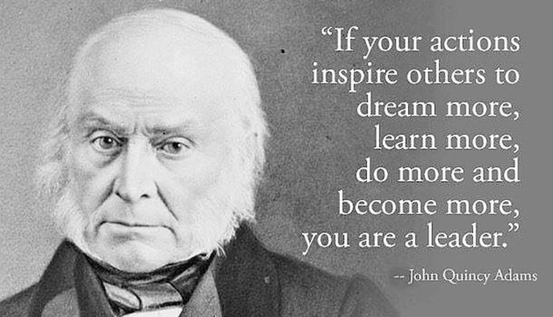
Conclusion
“People don’t care how much you know until they know how much you care.”
-- Fred Smith
https://startwithwhy.com/commit/leaders-put-people-first/
Notes:
Demonstrate to your employees you care about their lives and their safety.

Slide 37
Your Action Item for Leadership Development

Slide 38
Questions/
Contact Us
140 N. Otterbein Ave.
Westerville, Ohio 43081
info@safex.us
614.890.0800
@Safex-inc
@Safex.us
@SafexInc

